Slide 1
Exploring Pipelines
Maaret Pyhäjärvi

Slide 2
Exploratory Testing
TEST DESIGN
TEST EXECUTION
LEARNING
AGENCY
IMPACTFUL RESULTS

Slide 3
Exploratory Testing
TEST DESIGN
TEST EXECUTION
MANUAL
AUTOMATED

Slide 4
Exploratory Testing
TEST DESIGN
TEST EXECUTION
MANUAL
AUTOMATED

Slide 5
Exploratory Testing
MANUAL
AUTOMATED
LEARNING
AGENCY
IMPACTFUL RESULTS

Slide 6

(Engineering) Manager
Domain Specialist
(Polyglot) Programmer
Tester
Ops
(Exploratory) Tester

Slide 7
Content Warning Food: Animals

Slide 8
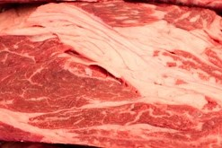
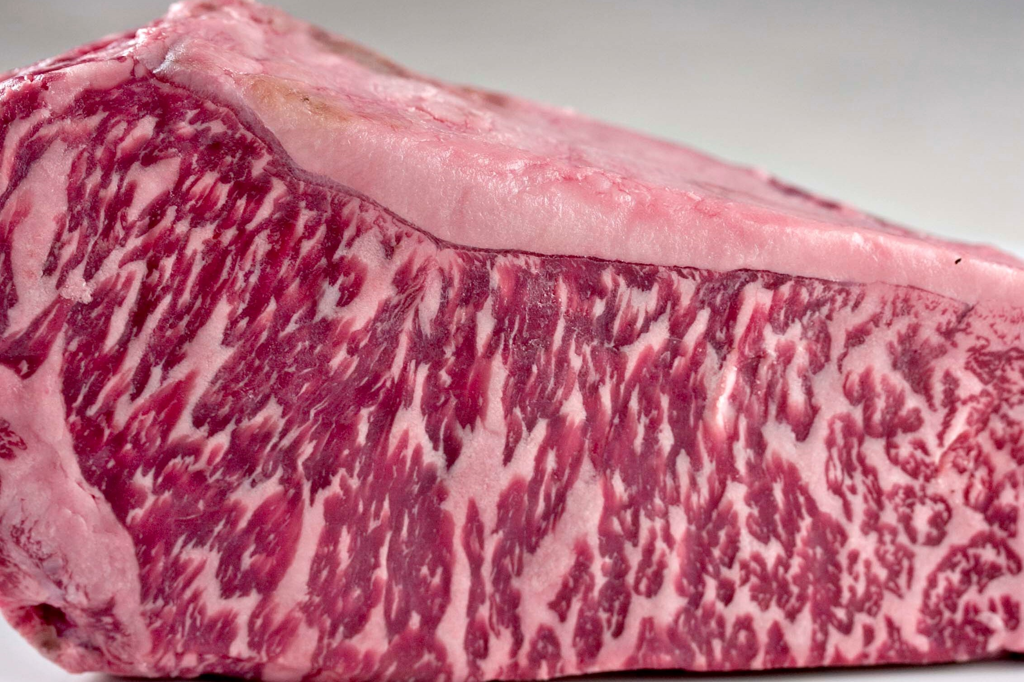
Metaphorically Speaking
Idea from
@HannesLindblom
15 $/kg
450 $/kg

Slide 9
Sprinkle On Top Exploratory Testing
Contemporary Exploratory Testing
Exploratory
UI
UI
Exploratory
SERVICE
SERVICE
UNIT
UNIT

Slide 10
Pipelines Connecting pieces of automation with automation

Slide 11
Exploring All The Way…
Single line
See it fail
First test
Same test but variables
Same test but templates
Failing test with a bug
Spec to tests
Guess the values that are likely to fail
Multiple browsers
Runs in CI

Slide 12
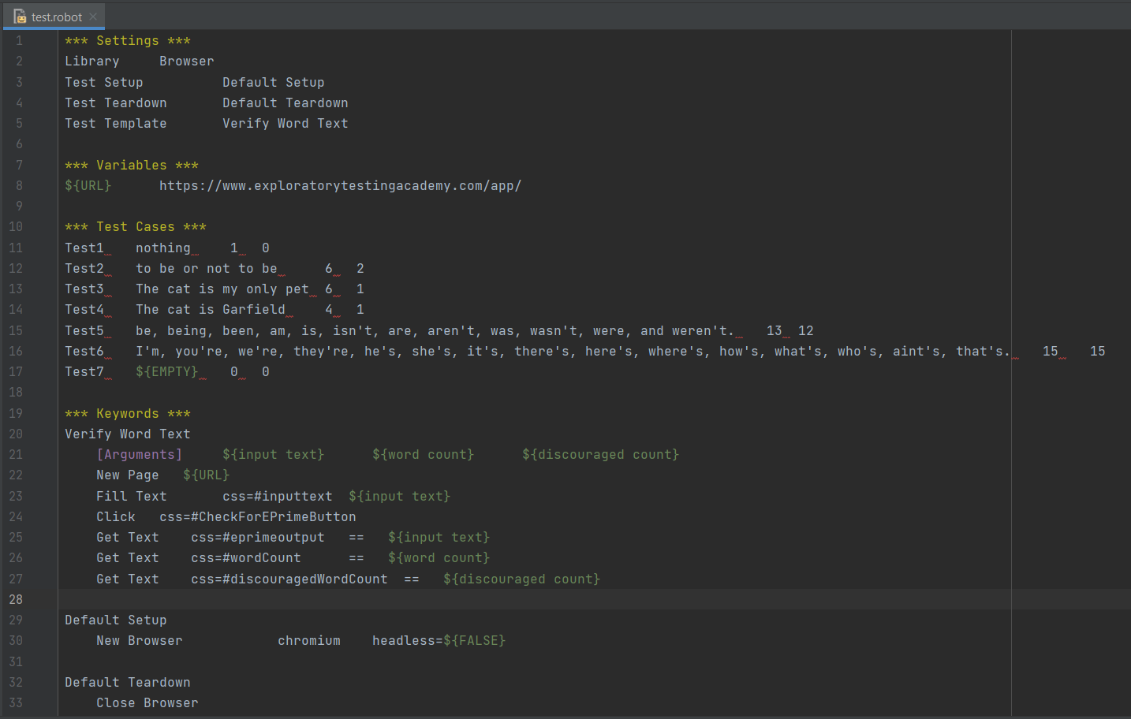
From a Piece of Code…

Slide 13
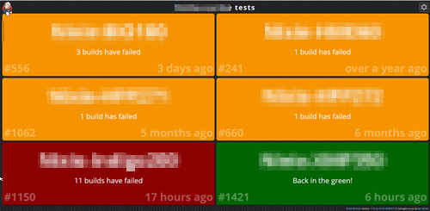
To Code in Pipeline(s)

Slide 14
Connecting Automation with Automation
On Schedule | On Trigger | On Demand II. Upstream | Downstream III. Visualize! IV. Repeatability.

Slide 15
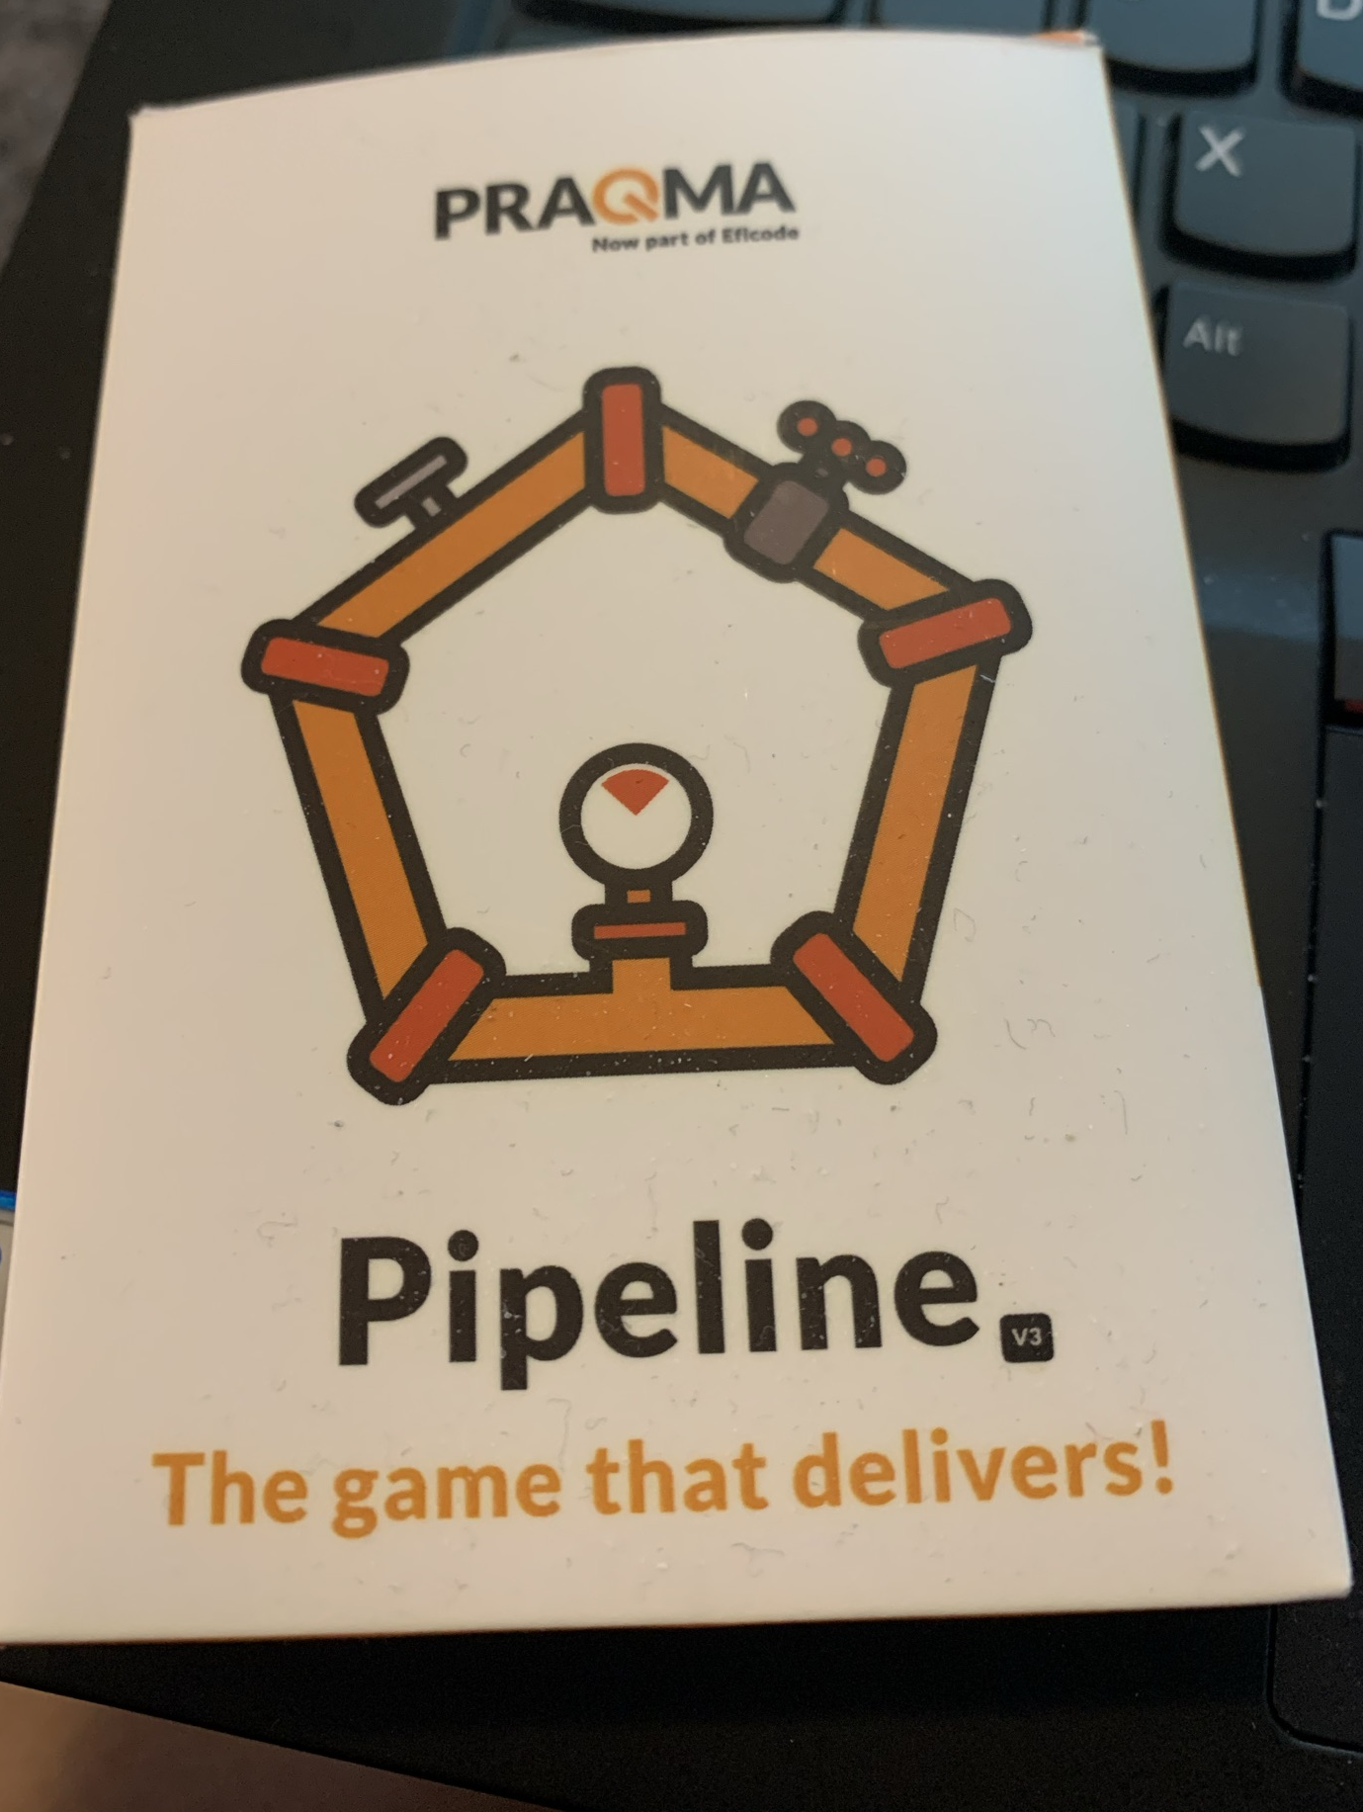
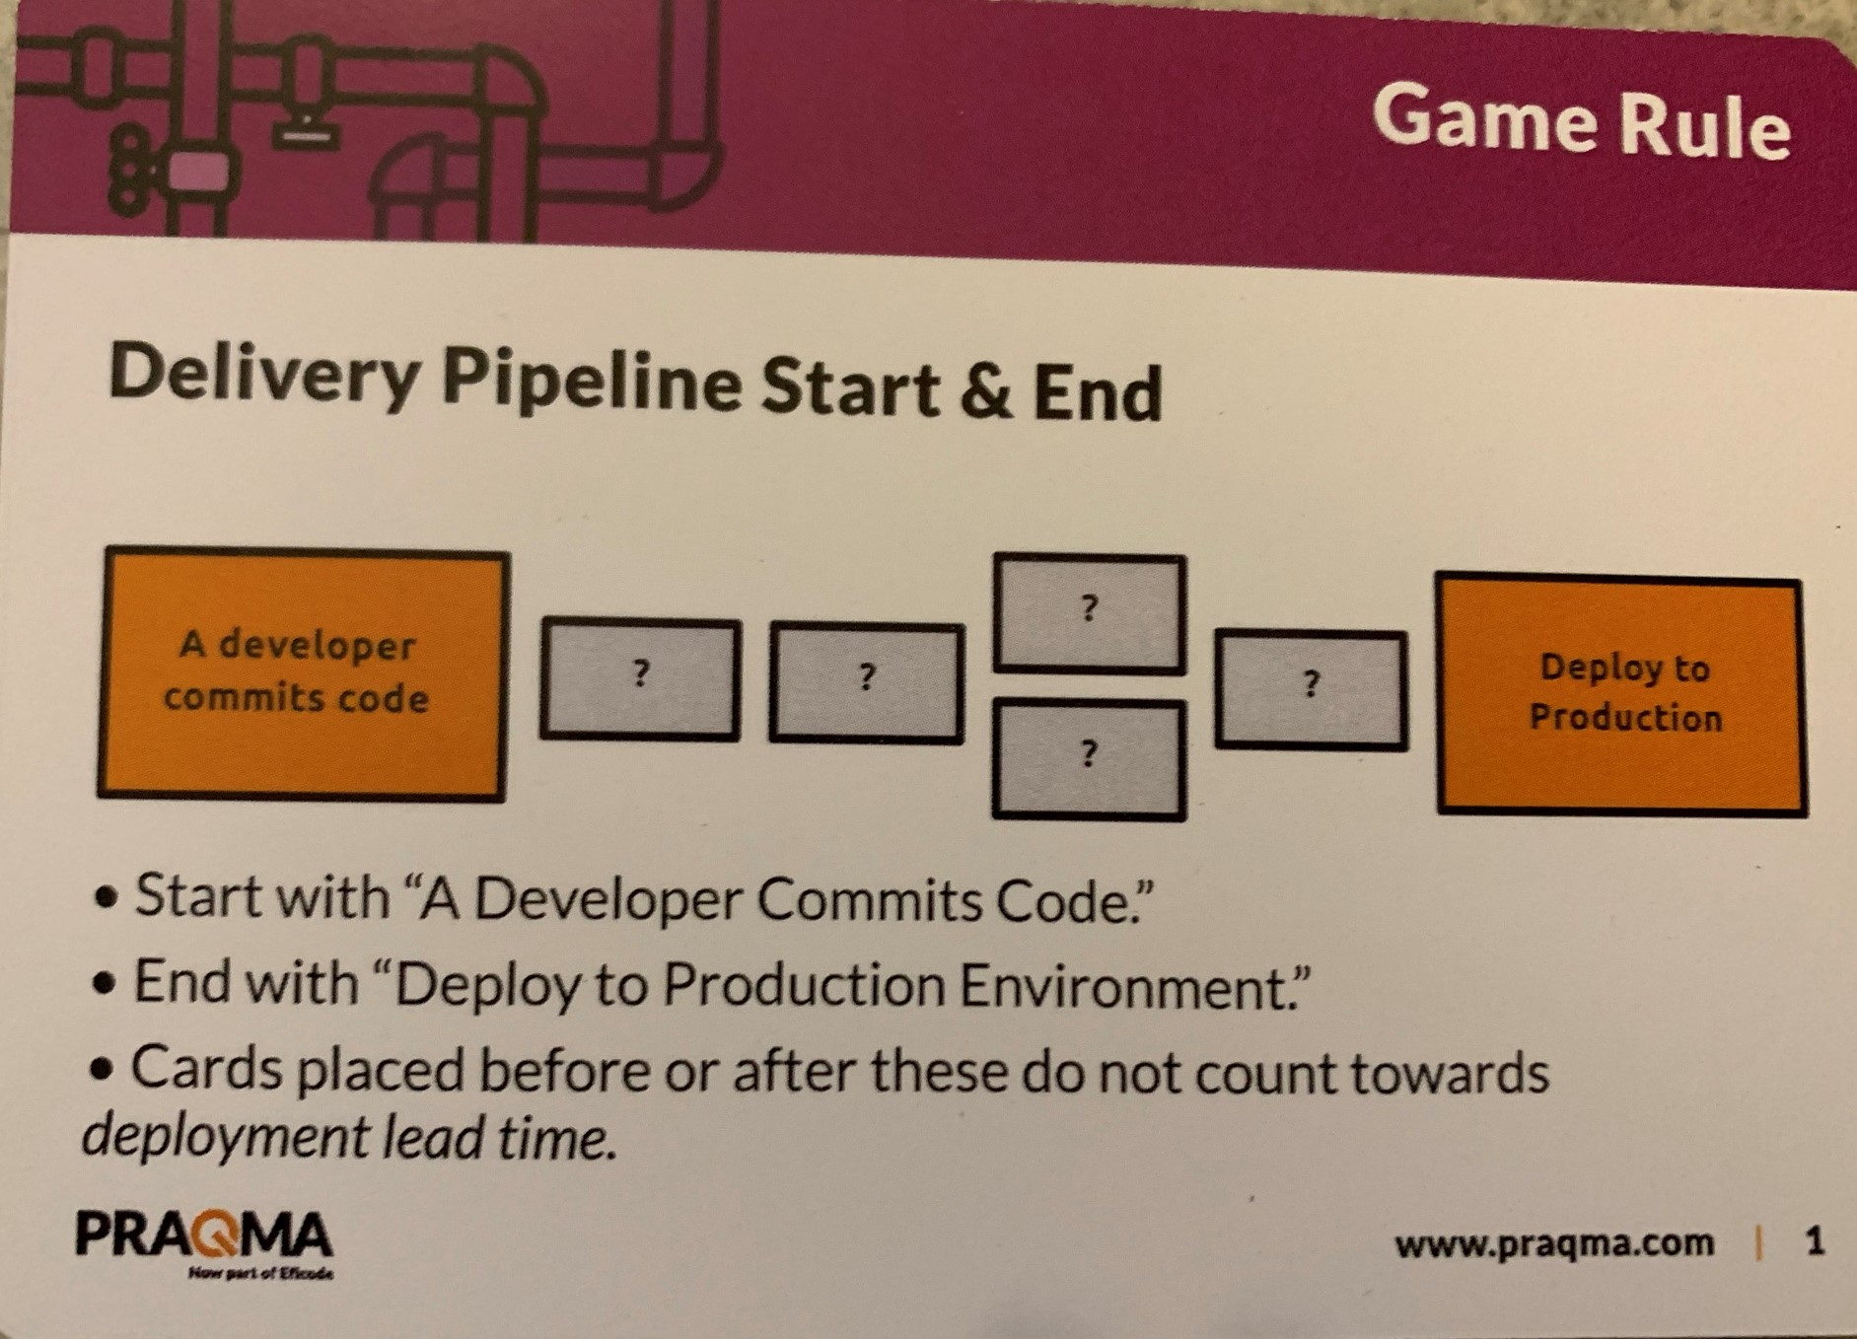
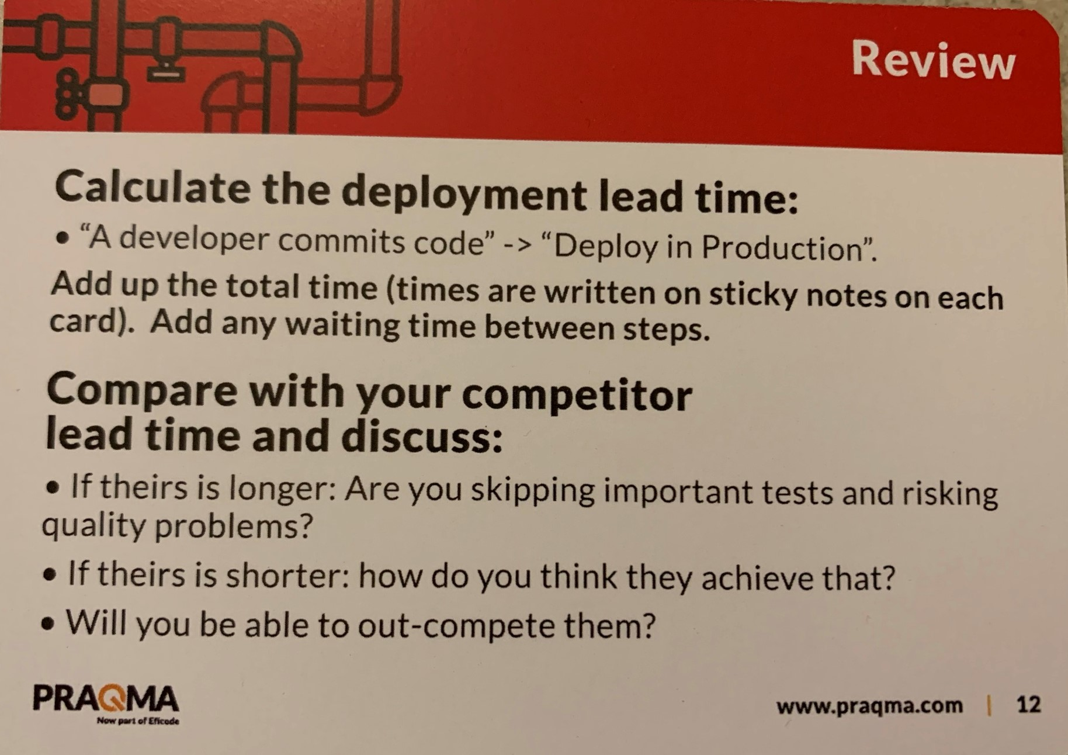
Created by Emily Bache
Based on work by Abby Bangser

Slide 16
Experiences
Daily releases without test automation.
Full code pipelines.
Rebuilding through exploring.

Slide 17
Incremental, incomplete, learning
Work towards flow of TA value - small streams become a significant pool over time. Moving for better continuously matter, not starting well or perfect.
Something imperfect but executable is better than great ideas and aspirations. Refactor to reveal patterns.
https://visible-quality.blogspot.com/2021/02/in-search-of-test-automation-strategy.html

Slide 18
DevOps
Turning more things into code.

